Slide 1
Pictures, Reference Schematics, etc.

Slide 2
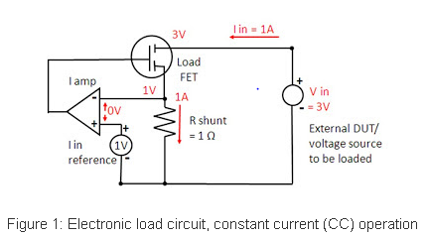
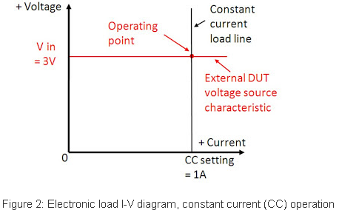
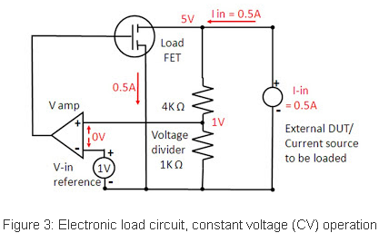
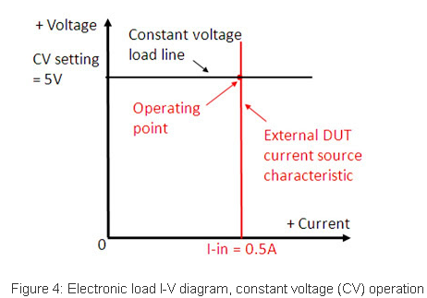
Basic Electronic Load Reference Schematics
Source: Keysight Technologies - Steven Lee

